Slide 1
CSCI 580 Discussion
HW 5
Lixing Liu
Slides modified from: Rongqi Qiu

Slide 2
HW4
Due 10/9 11:59 pm
No late submissions will be graded since HW4..
Regrading for HW1 - 3
One-time regrading opportunity
Please write your requests in README.txt along with your HW4 submission

Slide 3
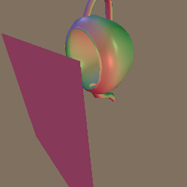
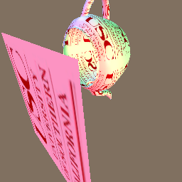
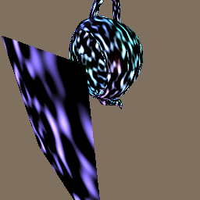
HW5 – Overview
Adding texturing capabilities to your renderer
HW4
Color specified by material attributes
HW5
Color specified by images
Color specified by functions

Slide 4
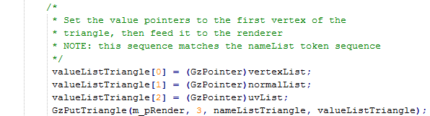
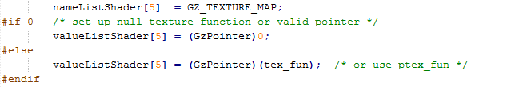
HW5 – Overview
Application5.cpp
Texture coordinates (u, v)
Texture function

Slide 5


HW5 – Overview
Application5.cpp
Texture coordinates (u, v)
Mapping from surface points to texture coordinates (u, v)
Image texture (tex_fun)
or
Procedural texture (ptex_fun)
Texture function

Slide 6
HW5 – Outline
Texture coordinates: surface point → (u, v)
Input: vertex → (u, v)
Replace (fixed) material color for (variable) texture color
Texture functions: (u, v) → RGB
Image texture
2D RGB image (look-up table)
Procedural texture
General computing functions

Slide 7
HW5 – Outline
Texture coordinates: surface point → (u, v)
Input: vertex → (u, v)
Replace (fixed) material color for (variable) texture color
Texture functions: (u, v) → RGB
Image texture
2D RGB image (look-up table)
Procedural texture
General computing functions

Slide 8
HW5 – Texture Coordinates (GzPutTriangle)
Assume we have defined a texture function
tex_fun(u, v) → RGB
Two remaining problems:
How to apply texture at vertices of triangles?
How to apply texture at interior of triangles?

Slide 9
HW5 – Texture Coordinates (GzPutTriangle)
Assume we have defined a texture function
tex_fun(u, v) → RGB
Two remaining problems:
How to apply texture at vertices of triangles?
How to apply texture at interior of triangles?

Slide 10
HW5 – Texture Coordinates (GzPutTriangle)
How to apply texture at vertices?
Retrieve (u, v) at this vertex (from input)
Call tex_fun to retrieve RGB color
What to do with retrieved RGB color?
Phong shading: Ka, Kd
Gouraud shading: Ks, Ka, Kd
Notes:
We will explain this choice in later slides

Slide 11
HW5 – Texture Coordinates (GzPutTriangle)
Assume we have defined a texture function
tex_fun(u, v) → RGB
Two remaining problems:
How to apply texture at vertices of triangles?
How to apply texture at interior of triangles?

Slide 12
HW5 – Texture Coordinates (GzPutTriangle)
Texture coordinates (u, v) are given only at vertices, but interior points need (u, v) too.
Solution: interpolation!
Similar to interpolating Z (during rasterization), RGB color (during Gouraud shading) and normal vectors (during Phong shading).
Either LEE or scan-line is fine.
Note: perspective correction (Class7, Slide 14)

Slide 13
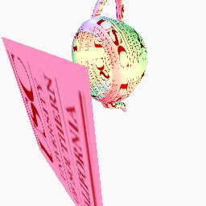
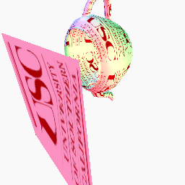
HW5 – Perspective Correction
perspective correction no perspective correction

Slide 14
HW5 – Perspective Correction
Object Space
World Space
Image Space
Perspective Space
Screen Space
Projection

Slide 15
HW5 – Perspective Correction
Object Space
World Space
Image Space
Perspective Space
Screen Space
Projection

Slide 16
HW5 – Perspective Correction
Object Space
World Space
Image Space
Perspective Space
Screen Space
Projection
This is where (u, v) is given.
This is where pixels are drawn.

Slide 17
HW5 – Perspective Correction
Object Space
World Space
Image Space
Perspective Space
Screen Space
(u, v)
(U, V)
Projection
(u’, v’)
(U’, V’)

Slide 18
HW5 – Texture Coordinates (GzPutTriangle)
Phong shading C = (Ks Σ_{L} [Ie (R•E)^{s}] ) + (Kd Σ_{L} [Ie (N•L)]) + (Ka Ia)
material attribute (fixed) texture lookup (pixel-by-pixel)
Gouraud shading (set K_{T}=Ks=Kd=Ka) C = (K_{T}) (Σ_{L} [Ie (R•E)^{s}] + Σ_{L} [Ie (N•L)] + Ia)
texture lookup compute at vertices (pixel-by-pixel) and interpolate to pixels

Slide 19
HW5 – Outline
Texture coordinates: vertex -> (u, v)
Given as input per vertex
Used for obtaining (variable) texture color in replacement of (fixed) material color
Texture functions: (u, v) -> RGB
Image texture
2D RGB image (look-up table)
Procedural texture
General computing functions

Slide 20
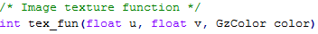
HW5 – Image texture (tex_fun)
Compute RGB color given texture coordinates (u, v)
Returns GZ_SUCCESS or GZ_FAILURE
Boundary test (u,v) within [0,1] x [0,1]
The codes for loading texture files are already given

Slide 21
HW5 – Image texture (tex_fun)
Problem: (u, v) range over [0, 1] x [0, 1], texture image is 2D array of (xs-1) x (ys-1)
Solution: scaling by the size of the texture image
u
x
Image texture resolution ([0, xs-1], [0, ys-1])
u,v coordinates range
([0,1], [0,1])
scale
v
y

Slide 22
HW5 – Image texture (tex_fun)
Problem: what if scaled (u, v) is not integer?
Solution: bilinear interpolation
Color(p) = s t C + (1-s) t D + s (1-t) B + (1-s) (1-t) A
s, t are fractional distances [0,1]
A, B, C, D are RGB colors at neighboring pixels
A
B
t
s
p
D
C

Slide 23
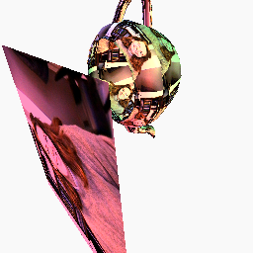

HW5 – Image texture (tex_fun)
Try other texture images!
Just replace the file “texture” with any ppm image.
Rendering using the left texture image
Example texture image

Slide 24
HW5 – Outline
Texture coordinates: vertex -> (u, v)
Given as input per vertex
Used for obtaining (variable) texture color in replacement of (fixed) material color
Texture functions: (u, v) -> RGB
Image texture
2D RGB image (look-up table)
Procedural texture
General computing functions

Slide 25
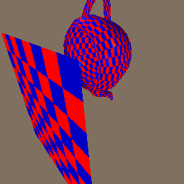
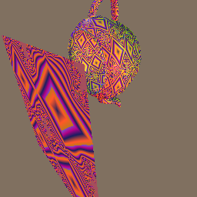
HW5 – Procedural texture (ptex_fun)
Any function of (u,v) is OK as long as a texture pattern is clearly evident. (i.e. Julia set)
Use your imagination!

Slide 26
HW5 pitfalls
- Perspective-Z: make sure the texture is not distorted on the plane and the teapot.
- Bilinear interpolation: make sure the texture is not too aliased.
- Procedural texture: do not forget to implement a procedural texture

